Slide 1
JNCIS-ENT
Intermediate System to Intermediate System (IS-IS)

Slide 2
IS-IS PDUs
2
Protocol Data Unit Deep Dive

Slide 3
PDU Types
IS-IS Hello (IIH) PDUs
Used to discover neighboring systems and determine Level (L1 or L2)
Link-state PDUs (LSPs)
Contains information about the state of a router's links and is used to exchange link-state information between routers.
Complete Sequence Number PDUs (CSNPs)
Provide a complete description of the link-state database
Used to synchronize link-state PDU databases
Similar to DBD OSPF packets
A DR multicasts CSNPs as acknowledgement for individual link-state PDUs
Partial Sequence Number PDUs (PSNPs)
Similar to an OSPF LSR packet

Slide 4
PDU Format - TLVs
IS-IS uses strictly defined Type-Length-Value (TLV) fields for all information
TLVs are the building blocks of IS-IS PDUs
Some TLVs are used in multiple PDUs, some are PDU-specific
The Type code defines the type of information contained
The Length code defines the length, in octets, of the field
The Value is the payload of the TLV, containing the information of the type specified.
Some Common TLVs:
TLV Code | TLV Usage
1 | Area addresses
2 | IS neighbor metrics
6 | Neighbor LAN ID
8 | Padding
9 | LSP entries
10 | Authentication information
128 | IP prefix, mask and metric (for IS-IS IP extension)
129 | Lists supported protocols
130 | IP external information
132 | IP interface address

Slide 5
IIH PDU
Used to discover neighboring systems and determine Level (L1 or L2)
Once adjacencies are established, the IIH PDUs are used as a keep-alive message
The IIH PDUs are sent at regular intervals, advertised in the ‘hello interval’ field of the PDU
Similar to the Hello packet in OSPF
IS-IS has 2 types of IIH PDUs, those used on broadcast links and those used on point-to-point (P2P) links
Broadcast IIH PDUs can be separated into L1 and L2 IIH PDUs, though the formats are identical
L1 and L2 Broadcast IIH PDUs are destined for the well-known multicast MAC addresses 01:80:C2:00:00:14 and 01:80:C2:00:00:15
By default, a DIS sends IIH PDUs every 3 seconds, and non-DIS send IIH PDUs every 9 seconds
Includes a list of all neighbors known to the originating IS

Slide 6
IIH PDU Format
Circuit type
Advertises the router as a L1, L2 or L1/L2 router
Source ID
Includes the system ID of the router that originated the PDU
Holding time
Similar to the 'Dead Interval' of OSPF, defines the amount of time to wait between receiving IIH PDUs before declaring the originating router dead
PDU length
Priority
LAN ID
In octets, specifies the length of the entire PDU
Used for election of the Designated Intermediate System (DIS) and is a value between 0 and 127
Includes the System ID of the DIS for this LAN segment. Includes 1 additional octet for differentiating this LAN segment from another that the same DIS may be designated for.

Slide 7
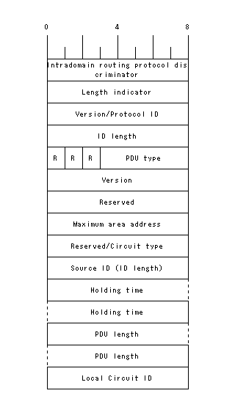
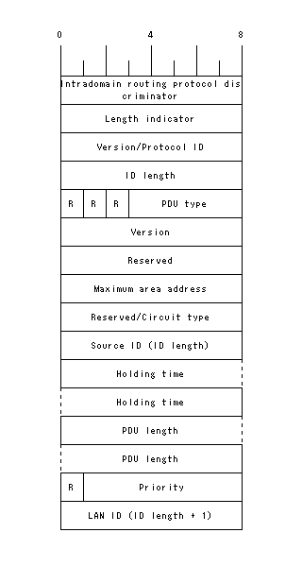
IIH PDU Format Details
IIH PDU on P2P Links
IIH PDU on Broadcast Links

Slide 8
Link-State PDU (LSP)
Similar to LSAs in OSPF
Describe reachable prefixes from the IS
Describe the IS’s adjacencies
Flooded periodically at regular intervals throughout an area
Also flooded when any of the following events are detected:
A directly connected link to a neighbor goes down
A new neighbor adjacency is formed
The cost to an existing neighbor changes
Separate LSPs are generated for L1 systems and L2 systems

Slide 9
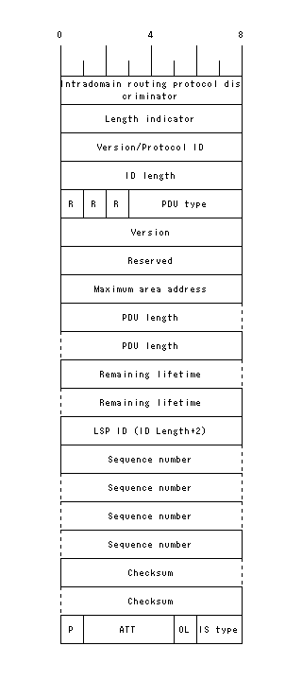
LSP Format

Slide 10
CSNP
Complete Sequence Number PDUs (CSNPs) are akin to the Database Descriptor (DBD) packets in OSPF
CSNPs contain a complete list of all the descriptors for all LSPs contained in the IS-IS LSP database.
IS-IS sends CSNPs periodically out all links, the receivers use this information to determine if their own databases are complete and up to date.
Only the DIS sends CSNPs on broadcast networks
The DIS on a broadcast link sends CSNPs instead of explicit acknowledgements for any received LSPs

Slide 11
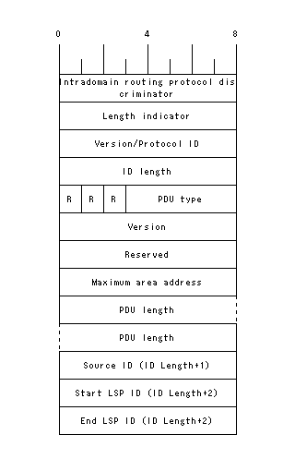
CSNP Format

Slide 12
PSNP
Partial Sequence Number PDUs are used to request Link-State PDUs
This is done when the PDU database is found to be out of date or an LSP is missing
PSNPs are destined for multicast address, towards the originator of the CSNP
The originator of the CSNP will see the header information in the PSNP and transmit the requested LSP to the requestor

Slide 13
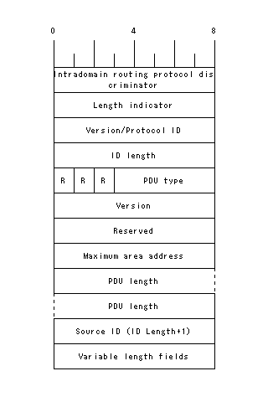
PSNP Format

